Slide 1

Gap Responsible
Understanding Defensive Line Player Value by Addressing Play-Specific Context and Player Responsibility
by Andrew Rogan
Assisted by Robert Bernhardt

Slide 2
Core Consideration 1: Context
Context is critical in evaluating player quality
Performance depends on many factors:
Situation
2nd & 1 vs. 3rd & 12
Responsibility/Assignment
Inter-position variation
DEs. vs. DTs.
Intra-position variation
0 Tech. vs. 1 Tech.
Intra-player variation
Joey Bosa at 5-technique vs. Joey Bosa as a 4-technique
Scheme, Formation/Front, Alignment

Slide 3
Alignment & Gap System
Our Linear Gap System
1
2
3
4
5
6
7
8
6
7
5
4
3
2i
1
1
2i
2
3
4i
4
5
7
9
4i
2
0
D
C
B
A
Ball
A
B
C
D
Y
1
2
3
4
5
6
7
8
Defensive Players are numbered based on the gap they are in on the snap
Offensive runs are numbered on the same scale, with the number indicating the intended gap

Slide 4
Quantifying Gaps Away
1
2
3
4
5
6
7
8
Play run to opposite B gap
Opposite Side 4i
Defensive Left B Gap (6 Gap)
Gaps Away
1
2
3
T
X
Play Direction: Left
Intended Gap: Offensive B gap (3 gap)
6 Gap – 3 Gap = 3 Gaps Away
B

Slide 5
Front Identification
Front types can be identified by counting the number of covered OL in the cylinder (also known as the “guard box”)
Odd: Cylinder Count = 1
Even: Cylinder Count = 2
Bear: Cylinder Count = 3
Goal Line: Cylinder Count = 4
Money: Cylinder Count = 0
Cylinder count: 1. Therefore this is an “odd” front.
E
N
E
CYLINDER

Slide 6
Core Consideration 2: Production Statistics
Statistics do not factor in situation, teammates, or scheme
Play value may depend on situation
Ex: Sack on 1st Down vs. 3rd Down
A play’s most important player may not record any statistics
Player control
America’s Blitz

Slide 7
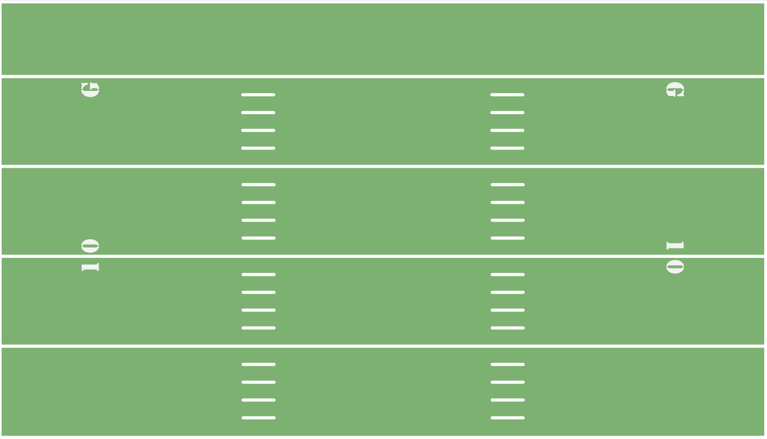
America’s Blitz
W
M
B
E
N
E
B
Two-on-one vs. back,
resulting in free rusher
Q
B
7

Slide 8
Methodology

Slide 9
Modeling Philosophy
“Agnostic” Modeling Approach
Treat player valuation through statistics as “unknowable”
Determine the value (EPA per play) a player brings solely by being on the field
Compare plays in which a player is present to plays in which a player is not
Assumption: any difference in EPA is attributable to the player
“Marginal EPA”
Difficulty: plays in which a player is present or not may be systematically different

Slide 10
Structure of Models
Model 1
Naïve Model: situational and team controls, with player-specific individual effects, group effects based on roster position (LB, DE, DT)
Models 2a, 2b
Determine which alignments/roles are most important in each front over the season
(Front-Specific, Alignment-Based Models, subsetting for even and odd front plays)
Models 3a, 3b
Determine who is most important on a given play type, using gap proximity and alignment
(subsetting for run and pass plays)

Slide 11
Model Set 1
Stage 1: OLS Regression
EPA_{ijk} = 𝛼₀ + 𝛴 𝛼_{k}+ 𝛴 𝛾_{k} + β X + 𝛴 𝛿_{i} + ε_{ijk}
Player i, Roster Position j, Team k
→ 𝛼_{k} , 𝛾_{k ,} , X : Team, opponent, & situation controls
→ 𝛿_{i} : Coefficient for on-field impact of player i (Marginal EPA)
→ Each 𝛿_{i} is relative to baseline group
Stage 2: Coefficient Extraction
Extract each 𝛿_{i} , group by roster position j , compare distribution

Slide 12
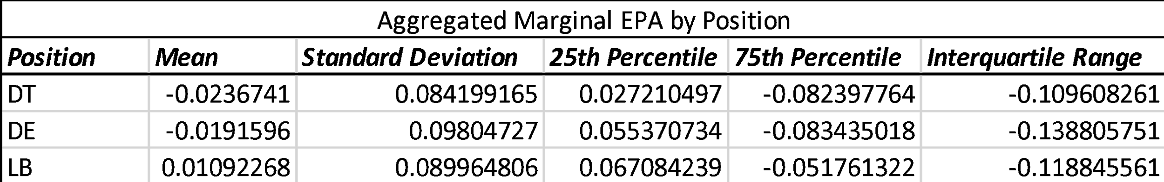
Model 1 Summary Stats

Slide 13
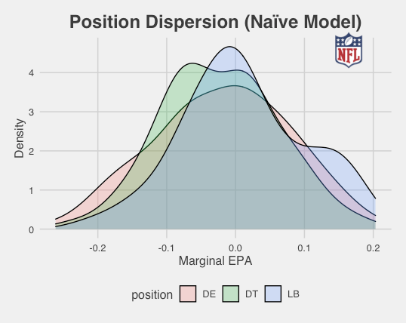
Model 1 Visualization

Slide 14
Model 1 Interpretation
DTs add the most EPA/play, LBs provide least value per play
DEs have the largest spread in Marginal EPA
There are somewhat more high-end outlier Marginal EPA DEs than DTs and LBs

Slide 15
Model Set 2
Stage 0: Split data by odd/even front
Stage 1: OLS Regression
EPA_{ijk} = 𝛼₀ + 𝛴 𝛼_{k}+ 𝛴 𝛾_{k} + β X + 𝛴 𝛿_{ij} + ε_{ijk}
j now subscripts alignment
Controls as before , baseline revised for player-alignments
𝛿_{ij} : Coefficients estimating the on-field value of player i in alignment j
Stage 2: Coefficient Extraction
Extract 𝛿_{ij} , group by position based on play-specific alignment (by front)

Slide 16
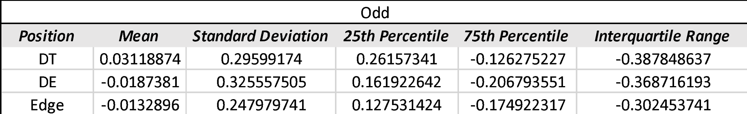
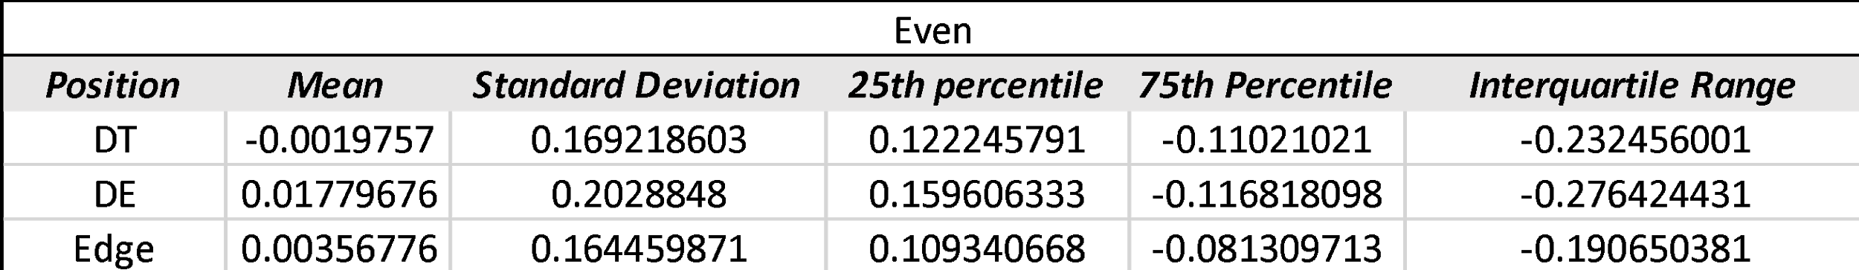
Model 2 Summary Stats

Slide 17
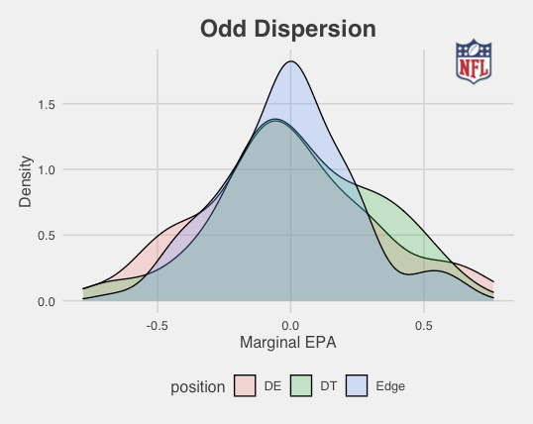
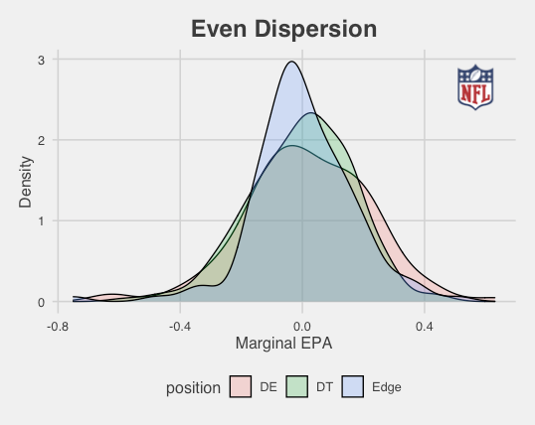
Model 2 Visualizations

Slide 18
Model 2 Interpretation
Odd Fronts:
DEs and Edge defenders have similar average Marginal EPAs; DTs generate less value
Edge defenders’ talent is heavily clustered
Even:
DTs provide best average Marginal EPA
DEs have the largest dispersion of talent

Slide 19
Model Set 3
Stage 0: Split data by run/pass play
Stage 1: OLS Regression
EPA_{ijk} = 𝛼₀ + 𝛴 𝛼_{k}+ 𝛴 𝛾_{k} + β X + 𝛴 𝛿_{ij} + 𝛴 𝜃_{ij} + ε_{ijk}
𝛿_{ij} : Coefficients for the on-field value of player i in position j
𝜃_{ij} : Coefficients for gap-proximity effect of player i in position j
Stage 2: Coefficient Extraction (Indicator & Gaps-Away)
Extract 𝛿_{ij} and 𝜃_{ij}, group by position based on play-specific alignment (𝜃_{ij} estimated for run plays only)

Slide 20
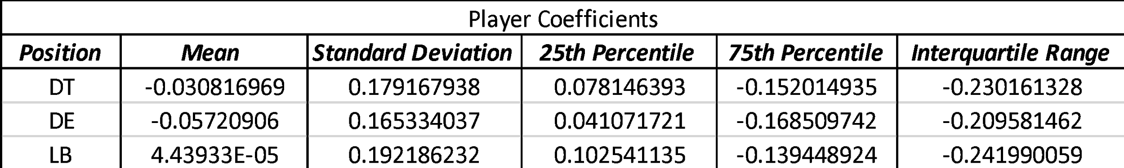
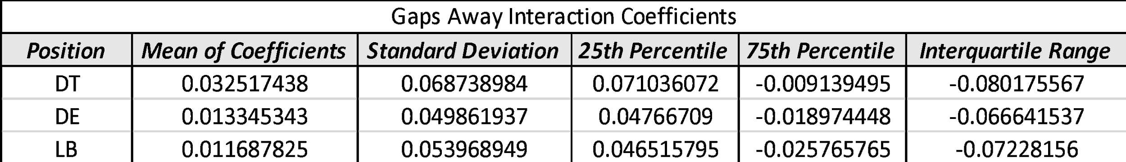
Model 3a Summary Stats (Run Plays)

Slide 21
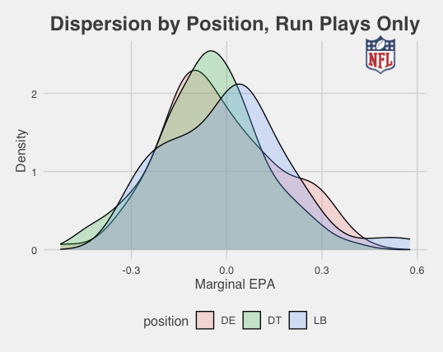
Model 3a Visualization (Run Plays)

Slide 22
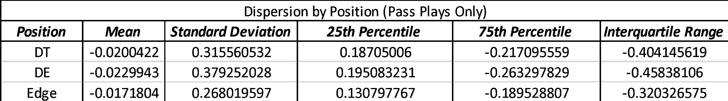
Model 3b Summary Stats (Pass Plays)

Slide 23
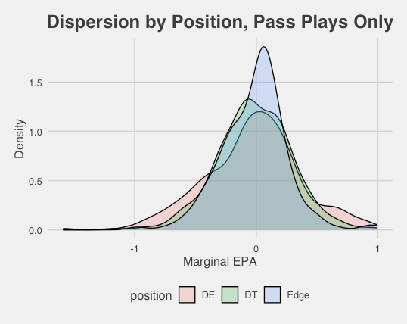
Model 3b Visualization (Pass Plays)

Slide 24
Model 3 Interpretation
Run Plays:
DEs generate the highest average value, followed by DTs then Edges
LBs have the greatest dispersion of value
Good players generate more value when closer to intended gap → especially DTs
Pass Plays:
DEs provide best average Marginal EPA & dispersion of value
LBs have the least value & have the smallest dispersion

Slide 25
Conclusions

Slide 26
Conclusions
Questions 1 and 2:
Marginal EPA is broadly comparable across positions
DTs generate higher value in even fronts; DEs have superior marg. EPA in odd fronts
DEs have the widest dispersion of talent → Top DEs generate more value vs. peers than DTs/LBs
Question 3:
Teams should consider the number of snaps they run at each front in the roster construction process
Above-baseline players generate more value when closer to intended gaps → strongest for DTs, negligible for LBs

Slide 27
Limitations & Extensions
Control for the interaction between situational factors
Include additional controls for offensive scheme
Account for teammate interactions & synergy
Gap and assignment variation
A remedy for this would be to record the gap the player played after the snap
Matchup information (ex: which offensive lineman they were blocked by)
Directional gaps away (in appendix)

Slide 28
Comments and Questions?
Thank you for viewing our presentation. We are honored to have been selected for the final round.

Slide 29
Special Thanks
A special thanks to those who have taught us all we know about football and data science:
Jake Dembow, Offensive Coordinator/OL Coach, Marist College
Tank Wright, Defensive Line Coach, Army
Dr. Phanindra Wunnava, Chair of Applied Economics, Middlebury College
Dr. David Munro, Assistant Professor of Economics, Middlebury College
Dr. Dan Bernhardt, Professor of Economics, University of Illinois Urbana-Champaign
Dan Rogan
Dave Caputi, Offensive Coordinator/OL Coach, Middlebury
The entire Middlebury football family. “Cheer Boys, Cheer!”

Slide 30
Appendix

Slide 31
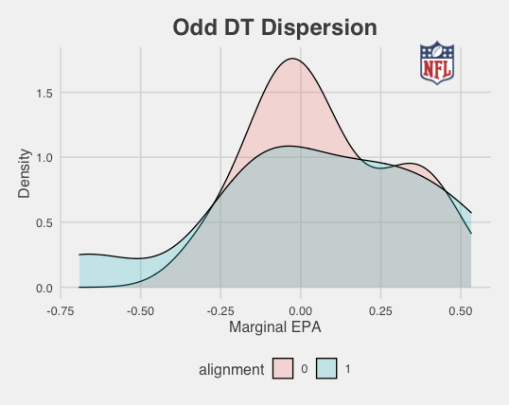
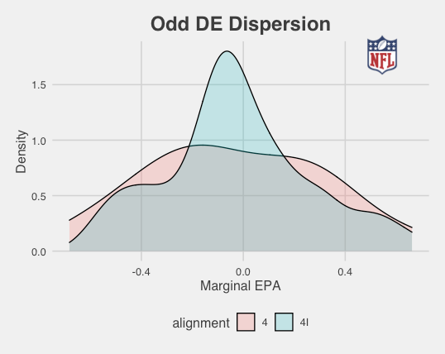
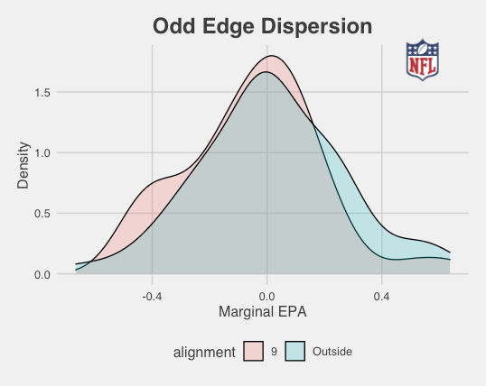
Model 2 Visualizations (Odd alignments)

Slide 32
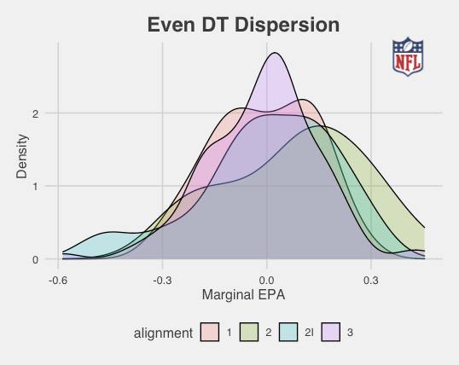
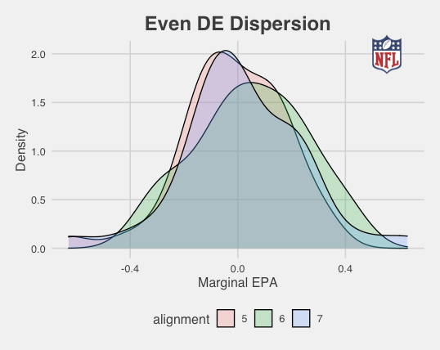
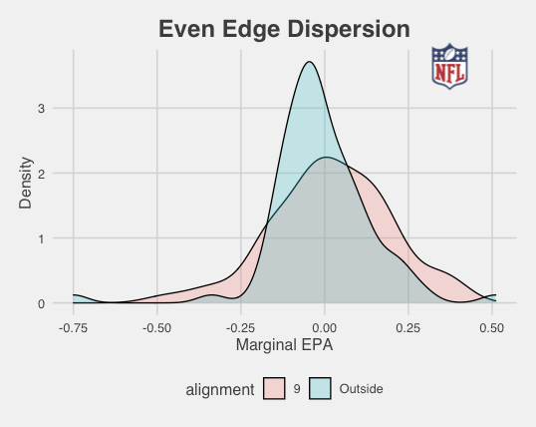
Model 2 Visualizations (Even alignments)

Slide 33
Front Identification

Slide 34
Front Identification
Fronts are often identified by the offense based off which of the interior OL are “covered” by the DL at the snap
For purposes of defensive line evaluation, identifying fronts is preferable to identifying entire defenses, especially given current data (ex: 4-3 and Nickel are different defenses on a high-level, but they are generally functionally equivalent for the DL, and treated similarly by the offensive line)
Almost all functional front possibilities can be classified into 5 basic front types:
Even (64% of observations in final data set)
Typically a four-man, single-gap front (4-3, 4-2-5/nickel, dime) with one guard covered and the center covered by DL (or both guards covered and the center uncovered)
Odd (24% of observations)
A 3-man front that involves either one-gap or two-gap (or both) DL (3-4, Quarter/3-man rush), with the center covered and guards covered (in rare instances, just one guard covered but the center and other OG uncovered)
Bear (also known as a “triple” or “90” front, 7% of observations)
Five-DL front used in short-yardage situations or against heavy personnel, with the center covered and both guards covered
Money (5% of observations)
Pass-rush situation front with none of the interior OL covered
Goal Line (.1% of observations)
Goal line/short-yardage situation front with both guards covered and the center double-covered (defense attempting to simply cancel gaps)

Slide 35
Odd
M
W
Schemes/Situations:
- 3-4
- 3-man rush
T
N
T
B
Q
Cylinder count: 1
Center covered, guards uncovered
B

Slide 36
Even
W
M
Schemes/Situations:
4-3
Dime
Nickel
General four-man rush
E
T
T
E
B
Q
Cylinder count: 2
Center covered,
one guard covered
B

Slide 37
Bear
M
W
Schemes/Situations:
Short yardage
Heavy offensive personnel
E
T
N
T
E
Y
B
Q
Cylinder count: 3
Center covered, both guards covered
B

Slide 38
Goal Line (cancelling gaps)
M
W
Schemes/Situations:
Short yardage
Heavy offensive personnel
E
T
T
T
T
E
Y
Center double covered, both guards covered
Q
Cylinder count: 4
B

Slide 39
Money
M
Schemes/Situations:
Passing situations
Dime
E
T
T
E
B
Q
Cylinder count: 0
Center uncovered,
both guards uncovered
B

Slide 40
“Even 2” (double 2 techs)
M
W
Schemes/Situations:
Passing situations (some rushing situations)
E
T
T
E
B
Cylinder count: 2. Thus, this is still an even front, even though the center is uncovered.
Center uncovered,
both guards covered
Q
B

Slide 41
Importance of Identifying Front
M
W
$
B
OLB becomes 6i
End reduces to 3-tech
N
B
E
E
Y
Cylinder count: 2. Therefore, offense will likely treat this as an even front, as it will act more like a 4-3, even though it is technically a 3-4 personnel.
In this situation, the defense has 3-4 personnel on the field (3 DL, 4L B), but has four stance players. Simply referring to this as a 3-4 would be misleading.
Q
B

Slide 42
Distinguishing Positions (Even)
W
M
(Edge)
(Tackle )
(Tackle )
(End )
(Edge )
E
T
T
E
B
Y
Players Grouped based on Gap:
DT’s=A and B Gap Defenders (1, 2i, 2, 3)
DE’s=C Gap Defenders (5, 7, 4, 6)
Edges=D Gap Defenders (9 and Outside)
Q
Note: 0s and 4is are rare in even fronts, but are classified here as DT’s, as they are A and B-gap defenders, and because players that utilize those alignments in even fronts most often have the body type and skill sets of DTs.
B

Slide 43
Distinguishing Positions (Odd)
M
W
(Edge)
(End)
(Tackle)
(End)
(Edge)
E
E
N
E
B
Y
Players Grouped based on Gap:
DT’s=A Gap Defenders (0, 1, 2, 2i)
DE’s=B and C Gap Defenders (4i, 4, 5, 6, 7)
Edges=D Gap Defenders (9 and Outside)
Q
B
Note: True 3 techniques are rare in odd fronts, but are classified here as DE’s since B-gap players are traditionally considered DE’s in odd fronts (ie: 4is).

Slide 44
Additional Data Cleaning Notes
Factoring out players with more than 550 snaps
It would be impossible to separate a player’s contribution to play EPA from the team’s EPA if he played every snap
We assumed that players included in the final data set should have played less than roughly 85% of their team’s snaps
Eliminating “Off Ball” alignments
Since we cannot determine technique/alignment for these players it is impossible to group them into accurately positions
“Off Ball” was extremely rare for players who are listed on rosters as defensive linemen
We do not consider inside linebackers in our analysis, only outside linebackers at certain alignments
Eliminating spikes and kneels
Important note: EPA is coded from the offense’s perspective.
Higher (positive) EPAs indicate better offensive performance on a given play, lower (negative) EPAs indicate better defensive performance

Slide 45
Additional Controls
Absscorediff: The absolute value of score differential. |DefensiveTeamScore-OffensiveTeamScore|
ToGo: Yards to go to gain a first down or touchdown
Down: Factor variable that represents current down on that play (ie: 1st, 2nd, 3rd, 4th)
Pass : Indicator variable that shows whether the play was a pass or run
Distancetogoal: Measures the yards a team is away from the opposing team’s endzone
TimeLeft: Time remaining in the game (renamed from initial data set)
Defense_Home: Binary variable that indicates if the defensive team is also the home team
Scramble (run data set only): Binary variable that indicates if a run play was intended to be a pass but resulted in a scramble
Shotgun: Binary variable that indicates if the offense was a shotgun formation at the snap
Redzone: Binary variable that indicates if offense has the ball inside their opponent’s 20 yard line
Lastfourfirsthalf: Binary variable that indicates if there are less than 4 minutes left in the first half (used to capture non-linear relationship between EPA and game time)
Lastfoursecondhalf: Binary variable that indicates if there are less than 4 minutes left in the game
Fronttype: Factor variable that controls for front structure (only used in full data models)
NameAlignment: Coefficient for a specific player at a specific alignment
OffensiveTeam: Factor variable indicating which team is on offense, thus controlling for team effects (49ers are the base group)
DefensiveTeam: Factor variable indicating which team is on defense, thus controlling for team effects (49ers are the base group)
Numberofrushers (pass data sets only): Counts the number of pass rushers on that play
ThrowDepth (pass data sets only): Measures the distance the ball traveled on the throw

Slide 46
Limitations and Areas for Further Analysis

Slide 47
Directional Gaps Away
“Playside”
Gaps to this side of the play gap are positive
“Backside”
Gaps to this side of the play gap are positive
1
2
-1
-2
-3
-4
Y
X
Play Direction: Left
Run gap: B gap
B

Slide 48
Directional Gaps Away Example 1
Play run to same side B gap
One gap to back side
Gaps Away
-1
T
X
B

Slide 49
Directional Gaps Away Example 2
Play run to same-side C gap
DE is two gaps to play side
Gaps Away
E
1
2
X
B

Slide 50
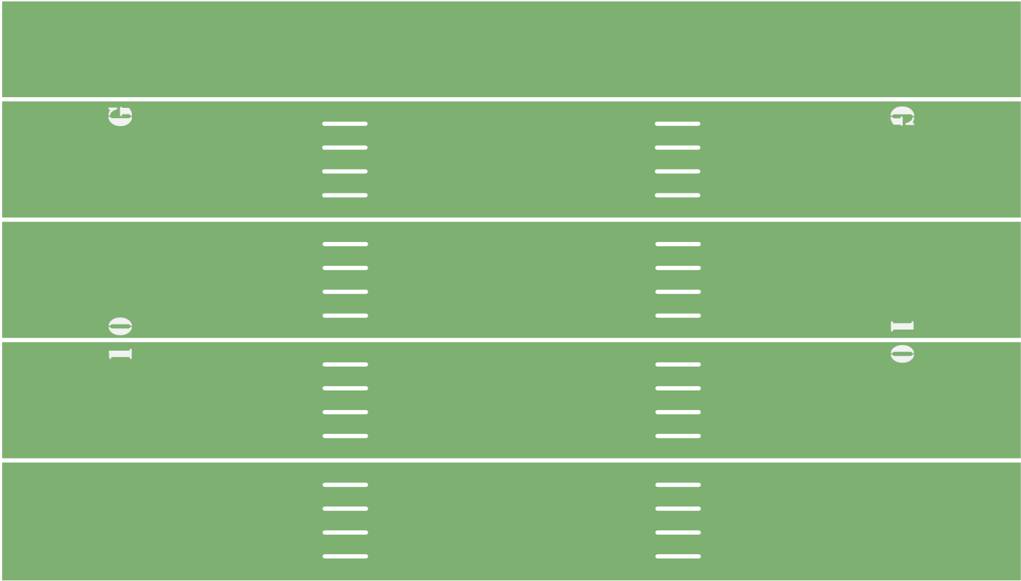
Relation to the Play
Weak Iso vs. Even (Over)
B
M
W
E
T
T
E
Y
Q
F
Backside end is 6 gaps away, not nearly as important as playside end, who can easily make a positive or negative impact on play due to his proximity to the intended gap
B

Slide 51
Relation to the Play
Weak Iso vs. Even (Over)
B
M
E
T
T
W
E
Y
Q
Most likely gaps to be used (if not designed gap) are adjacent gaps
F
B

Slide 52
Relation to the Play
Weak Iso vs. Even (Over)
B
M
E
T
T
W
E
Y
Q
Most likely gaps to be used (if not designed gap) are adjacent gaps
F
B

Slide 53
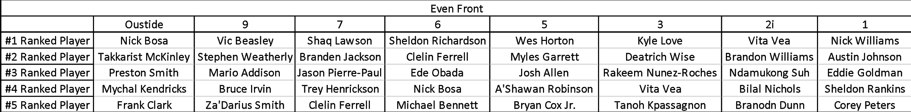
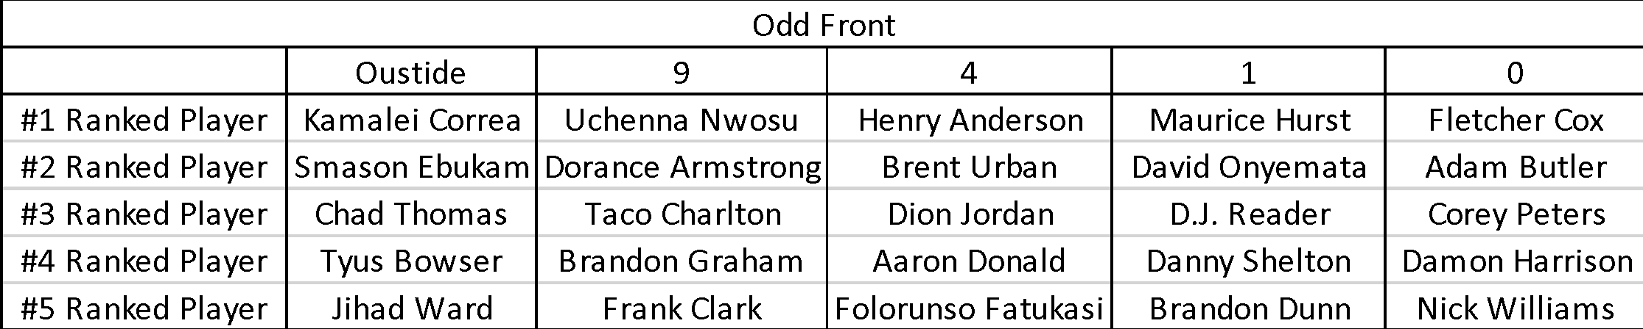
Highest Rated Player Alignments by Front (Model 2)
(Just off list at Outside: #6 Melvin Ingram, #7 Cameron Jordan, #8 Everson Griffin, #9 Marcus Davenport)
53

Slide 54
Fundamental Issues with Performance Statistics

Slide 55
“Player Control” Fronts
M
W
B
E
N
E
Q
B
55

Slide 56
America’s Blitz
America’s Blitz (also known as ‘Blast,’ ‘Tornado,’ or ‘USA’)
America’s Blitz is a zone or man pressure (typically zone) that relies on a defensive linemen slanting two gaps in order to use up two offensive linemen and free up two rushers off the edge of the offensive line
In the diagram on the following slide, if the line slides away from pressure in a typical 4-man slide, the tackle will be responsible for a 1-on-1 against the 4i.
If the defensive end forces the guard and tackle to be slow on their exchange, the edge defender and inside linebacker will both come free off the edge, resulting in a 2-on-1 on the RB and a free rush on the quarterback
In this example, the inside linebacker and edge defender would be credited with a pressure and sack, even though the more important role defensively is arguably that of the defensive lineman who enabled them to get a free rush (as well as the center or quarterback who slid protection the wrong way, or the tackle who was fooled by the DE and was slow to recognize the blitz).
Again this can be controlled for by utilizing our “agnostic” econometric strategy
56

